Slide 1
How much do you love documenting everything?

Slide 2
What does your file room look like?

Slide 3
Does it look like this?

Slide 4
Or more like this?

Slide 5
Maybe this is more like it…

Slide 6
Is this you?

Slide 7
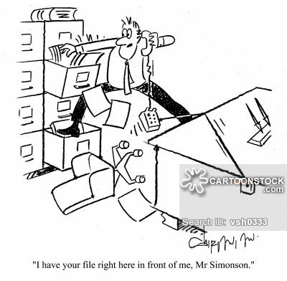
Did this ever happen to you?

Slide 8
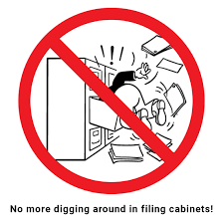

Slide 9
This could be you!

Slide 10
Digital Documentation
It’s about your time and space.

Slide 11
Onsite or digital What’s best for you?
Onsite
Inexpensive
Storage space for multiple file cabinets
Labor intensive
Reordered each year
Shred sensitive information
Load into boxes
Impacted by weather
Digital
With an outside provider or within district
No physical space
Not labor intensive
Scan documents
Easy to delete files after 5 years
No shredding
Protected from weather

Slide 12
Network Drive (St. Charles)
Media Share is a network drive that lives on the district’s server.
Protected by district firewall
Backed up to a secure site with all confidential district information
Limited to assigned users
Managed by federal programs

Slide 13
St. Charles

Slide 14
Blackboard (Calcasieu)
Real Time access from any device and location.
Ease of use for desk monitoring/auditing
No additional cost
Protected by district firewall/ multiple backups
Limited Assigned Users
Every site uploads their adobe documents into designated folders.

Slide 15
Terrebone Title I Crate
EASY Title I Document Management!
・Monitor Crates in Real-Time
・LIVE access to your “District Administrator Monitoring Tool” upon login to your Crate
・Utilize your STATE MONITORING INSTRUMENT within your Customized Crate
・Automatic Email Reminders
・Easy Campus Login to Attach Documents to their own Crate
・Secure Storage of Documentation for 7 years and backed up daily on 3 servers
・Unlimited number of users
・MULTIPLE PROGRAMS: Title II, III, X ESL, SpED, etc. can be monitored in Title1Crate
・LIVE CHAT and Unlimited FREE Support

Slide 16
Terrebonne Parish's Title I Crate
Link to Title I Crate
But, the real question is …. How Much?
District Crate: $500.00
Campus Crate: $500.00
Your TIME and WORRY SAVED:
PRICELESS

Slide 17
EBR Google Drive
Google Drive is a file storage and synchronization service created by Google. It allows users to store files in the cloud, share files, and edit documents, spreadsheets, and presentations with collaborators. Google Drive encompasses Google Docs, Sheets, and Slides, an office suite that permits collaborative editing of documents, spreadsheets, presentations, drawings, forms, and more.
LIVE access to your drive from any device and any location.
Monitor schools from any device and any location.
https://www.google.com/drive/
https://www.google.com/drive/

Slide 21
Contact Information
Peggy Marcel
Title
Terrebonne Parish
Address
Phone
email
Melonie Wallace
Federal Programs Technology Consultant
Calcasieu Parish
Melonie.wallace@cpsb.org
Thaddeus Sam
Title I Coordiantor
East Baton Rouge Parish
1022 South Foster Dr.
Baton Rouge, LA 70806
(225) 223-5352
tsam@ebrschools.org
Sharon Woolf
Title I Coordinator
St. Charles Parish
Address
Phone
email

